Slide 1

Building Robust AML Models: Advanced Techniques for Effective Transaction Monitoring
Addressed Inefficiencies of the model and shared insights of developing state-of-the-art AML Compliance Models
Prepared By: Souvik Ganguly
Date: 2nd June 2024

Slide 2
Index
Index
Executive Summary
Data Overview and DQ Report
Parameter Tuning
Threshold Evaluation Metrics
Optimum Threshold Selection
Methodology Optimization- Tuning Threshold using Recall evaluation metric
Summary of Project and Key Learnings
My Expertise: I can help you build a Robust State-Of-The-Art AML Compliance Model. Let’s get on a call !

Slide 3
Executive Summary
Overview:
In this project, I have applied advanced statistical techniques to optimize Anti-Money Laundering (AML) transaction monitoring for large value deposits. The objective was to develop a market-standard solution for the scenario: Large Value Deposits that enhances the detection of suspicious activities while minimizing false positives, reflecting the stringent compliance requirements of financial institutions.
Purpose:
The primary goal of this project is to demonstrate my ability to interpret and analyze data to make informed financial crimes decisions. By tuning the monitoring thresholds effectively using the Marker standard methodologies, I aim to maximize the detection of true suspicious activities, reduce generation of False Negatives and reduce operational costs associated with false positives.
Relevance:
This project showcases a tuning methodology that is widely used in the banking sector. But this method is inefficient due to large number of False Positives, and presence of False Negatives. In the end, based on my 6+ years of experience in AML Compliance Analytics I explain the inefficiencies in these models and steps on how to develop efficient AML models- Rule based and ML Based(Segment the customers, products etc.) models. I play an instrumental role in bridging the gap between the inefficient standard scenario tuning methodology and build state-of-the-art in-house AML models.
GitHub Repository:
You can click here to explore the script written for tuning the threshold suing J-statistics, F1-Score and Recall Metrics. Steps to replicate the project is mentioned in the repository

Slide 4
Data Overview and DQ Report
Data Overview: In this project, I utilized two datasets to conduct a thorough analysis:
Accounts.csv:
Description: Contains account-level information.
Key Variables:
ACCOUNT_ID: Unique identifier for each account.
IS_FRAUD: Target variable indicating whether the account is associated with suspicious activity (True for suspicious, False for non-suspicious)
Transactions.csv:
Description: Contains transaction-level details.
Key Variables:
SENDER_ACCOUNT_ID: ID of the account initiating the transaction.
RECEIVER_ACCOUNT_ID: ID of the account receiving the transaction.
TX_AMOUNT: Amount of money involved in the transaction.
Data Quality Report (DQ Report): The DQ Report was generated to identify and address potential issues in the datasets:
Missing Values: Both datasets were examined for missing values to ensure completeness and reliability.
Unique values: Checked for unique values in key variables to validate the integrity of the data.
Distribution: Analyzed the distribution of numerical variables to identify outliers and skewness.

Slide 5
Parameter Tuning
Parameter Tuning:
Focus Parameter DEPOSIT_AMT: Selected due to its critical role in identifying large value transactions, which are often indicative of suspicious activity.
Threshold Summary File:
Generated a detailed summary file encompassing percentile distributions from 1 to 99.
Calculated thresholds and corresponding evaluation metrics for each percentile.
Process:
Aggregate Transaction Data: Grouped transactions by RECEIVER_ACCOUNT_ID to calculate total deposit amounts (DEPOSIT_AMT).
Threshold Calculation:
For each percentile (1-99), calculated the threshold value for DEPOSIT_AMT.
Evaluated the impact of each threshold on alert generation.

Slide 6
Threshold Evaluation Metrics
To determine the optimal threshold for DEPOSIT_AMT, we evaluated multiple metrics to balance detection efficiency and operational feasibility. These metrics help in assessing the performance of different thresholds and selecting the most effective one.
Key Metrics
True Positive Rate | False Positive Rate | Precision | F1 Score | Youden’s J Statistics
Definition: Proportion of actual suspicious transactions correctly identified. Importance: Ensures high detection of suspicious activities, minimizing the risk of undetected fraud. Recall: TP/(TP+FN) | Definition: Proportion of non-suspicious transactions incorrectly flagged as suspicious. Importance: Reducing false positives helps minimize the operational costs associated with investigating non-suspicious alerts. FPR: FP/(FP+TN) | Definition: Proportion of identified suspicious transactions that are actually suspicious. Importance: Balances the trade-off between catching true positives and avoiding false positives. Precision: TP/(TP+FP) | Definition: Harmonic mean of precision and recall. Importance: Provides a single metric that balances both precision and recall, useful in cases of imbalanced classes. F1: 2 *(Precision * Recall)/(Precision + Recall) | Definition: Balances sensitivity (recall) and specificity. Importance: Identifies the optimal threshold by maximizing the difference between true positive rate and false positive rate. J Statistics: TPR - FPR

Slide 7
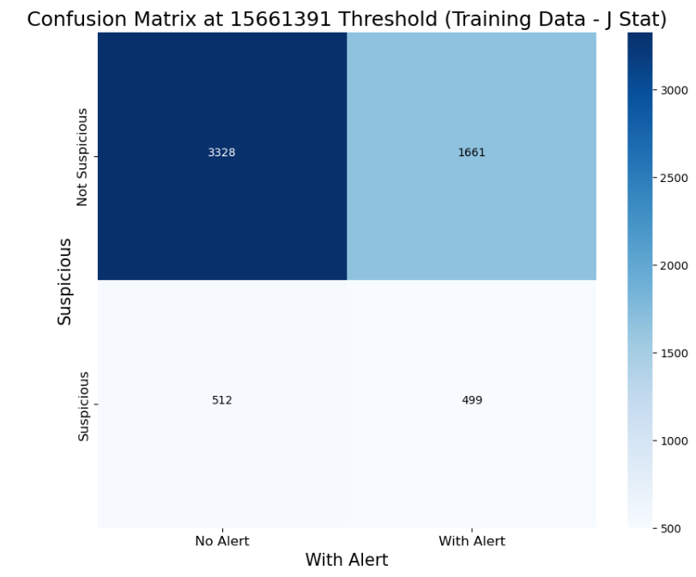
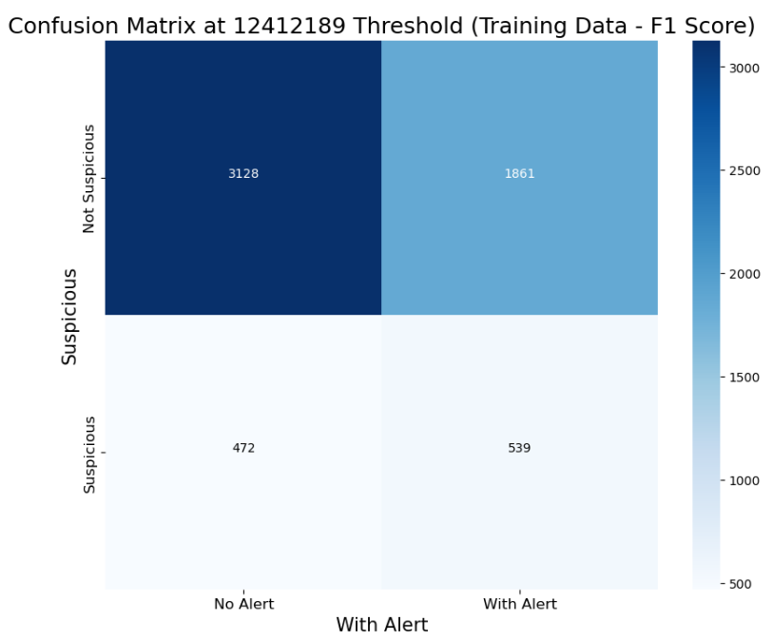
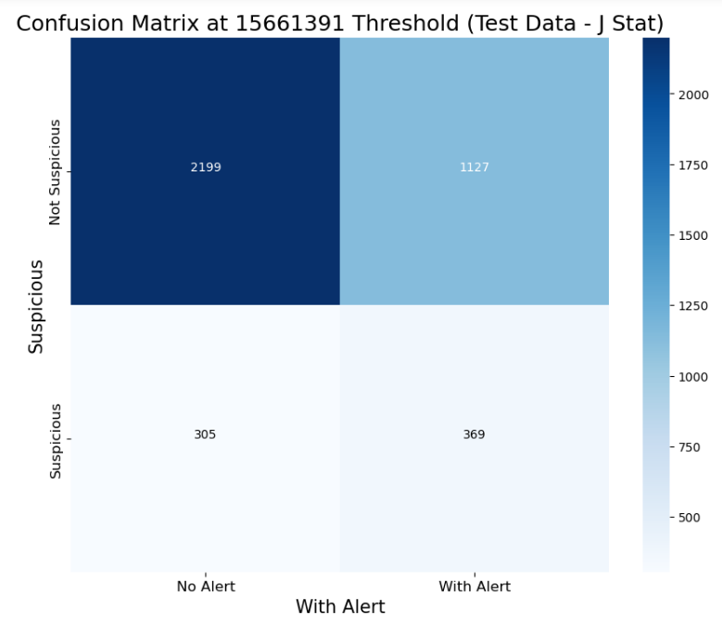
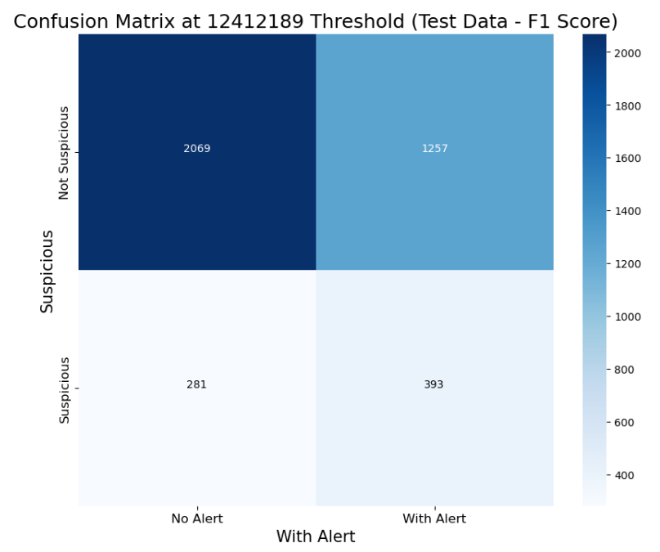
Optimum Threshold Selection
Determined the best threshold using Youden's J Statistic and F1 Score.
Visualized confusion matrices to compare the effectiveness of each threshold.
Inference with Train Dataset:
J-statistics: 512 Suspicious alerts are predicted as Non-Suspicious
F1 Score: 472 Suspicious alerts are predicted as Non-Suspicious
Inference with Test Dataset:
J-statistics: 305 Suspicious alerts are predicted as Non-Suspicious
F1 Score: 281 Suspicious alerts are predicted as Non-Suspicious
Conclusion:
False Positives are lower using both J-statistics and F1-score
False Negative is lower while using F1 score as metric for tuning compared to J-statistics.
Even though False negative is lower using F1 score relatively, 7.86% and 7% FP in train and test data sets can be unacceptable for a market based on their risk tolerance.
As a result, this tuning approach should be optimized

Slide 8
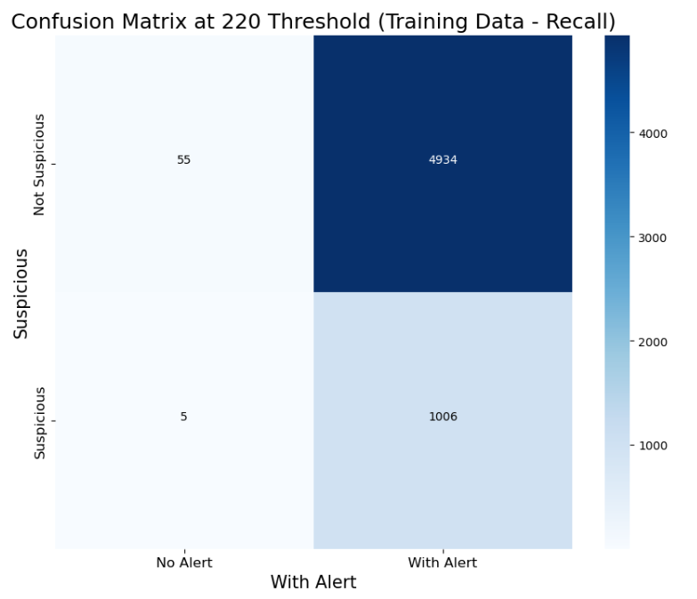
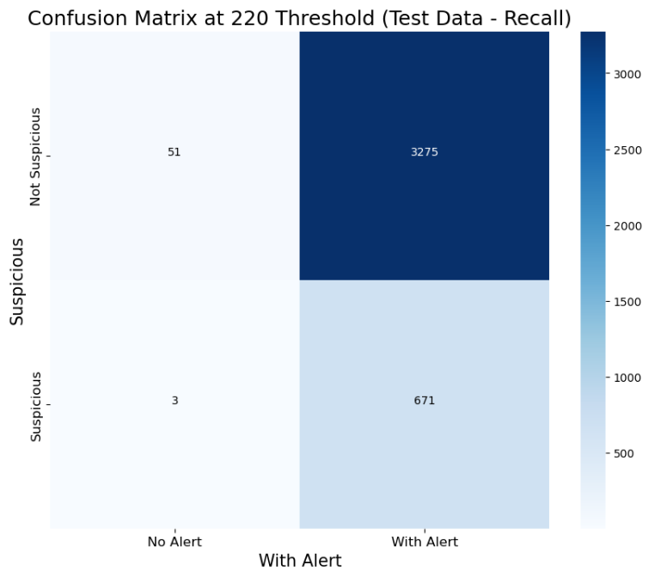
Methodology Optimization- Tuning Threshold using Recall evaluation metric
In AML monitoring, minimizing false negatives is crucial to ensure that suspicious activities are not missed. Therefore, recall is a key metric to optimize, as it Ensures that the monitoring system captures as many suspicious activities as possible, reducing the likelihood of undetected fraud.
Steps for Optimization:
Identify Best Threshold: Analyzed the threshold_summary_file to identify the threshold with the highest recall.
Validate on Training Data: Applied the identified threshold to the training data to evaluate performance.
Validate on Test Data: Applied the same threshold to the test data to ensure generalizability and robustness.
Conclusion:
False Negatives have substantially decreased from 472 to 5 for training data and 281 to 3 for test data but for higher risk markets missing 5 alerts may not acceptable as per their risk tolerance.
Also, tuning using recall metric has set up the thresholds very conservative generating 82% False Positives.
Hence, even though tuning using Recall results in increased risk coverage, it increases the operational cost of manually investigating the alerts.

Slide 9
Summary of Project and Key Learnings
In this project, we applied advanced statistical techniques to derive thresholds for Anti-Money Laundering (AML) transaction monitoring scenario Large Value Deposits. Our goal was to:
Develop a market-standard solution that enhances the detection of suspicious activities while minimizing false negatives and false positives
Reflect and conclude why these methods are not the most efficient solutions for the use case and bulletproof
Summary and Key Learnings:
Metrics Used For Tuning
J- Statistics Score | F1- Score | Recall
Merits: Balances sensitivity and specificity, providing a robust measure for optimal threshold selection. Demerits: May not always prioritize the highest recall, potentially missing some suspicious activities. | Merits: Balances precision and recall, offering a comprehensive view of performance. Demerits: May not effectively reduce false negatives to the desired level. | Merits: Maximizes the detection of suspicious activities, ensuring high coverage of risk. Demerits: Leads to a higher number of false positives, increasing operational costs.

Slide 10
My Expertise- I can help you build a Robust State-Of-The-Art AML Compliance Model. Let’s get on a call !
To tackle such problems, seasoned professionals trained and experienced in designing, developing and maintaining Compliance, AML, Risk models are required to develop state-of-the-art Models. I can help you develop a robust AML Framework and design maintenance frameworks . Below are a few suggestions from my arsenal:
Sophisticated Scenarios: Different AML scenarios require unique designs addressing multiple aspects of the transactions. Scenarios should address the following aspects: Eligible transactions and bank products for the scenario, look-back period, what segment of population is eligible etc.
Data Preparation: It should address the filter conditions based on the scenario design, Generate exhaustive Data Quality report, remove transactions that are left skewed and not contributing to alerts etc.
Different Tuning Methodology: Adopt advanced statistical tuning methodologies that increases risk coverage and reduces False Positives. If Regulators permit, Machine Learning models give good results and is cost effective when it comes to optimize/ re-tune the model
Tailored Metrics: Evaluation metrics must be tailored to each specific use case, bank product, and transaction type to achieve optimal results. Metrics need not be very complex. It can be as basic as alert volumes, conversion rates of transactions to alerts, alerts to suspicious alerts etc.
Post Detection System: Develop a robust Post Detection system that either reduces False Positives or prioritizes the alerts to reduce operational cost.
Model Monitoring and Optimization mechanism: This framework will give you constant feedback regarding health of the model and scope for constant improvement.
Skills and Expertise:
Analytical Proficiency: Expertise in data analysis, statistical modeling, and AML compliance.
Industry Experience: Hands-on experience in developing and tuning AML models, both rule-based and machine learning-based, at HSBC and Infosys.
Technical Skills: Proficient in Python, SQL, and advanced data analysis tools.
Strategic Insight: Ability to design and implement efficient AML solutions that are tailored to specific business needs and regulatory requirements.

Slide 11
THANK YOU
Contact me at
Linkedin
E-mail: souvik.ganguly.ds@gmail.com

